Slide 1

DigiTalyer
On-Demand Mekaniko for Your Auto
Autoserved
Eskwelabs
01/27
Next

Slide 2

Eskwelabs x Autoserved
The Problem
01
Methodology & Data Science Tools
02
Key Topics
Exploratory Data Analysis
03
Modeling Results
04
Conclusions & Recommendation
05
Table of Contents
Back
Next

Slide 3

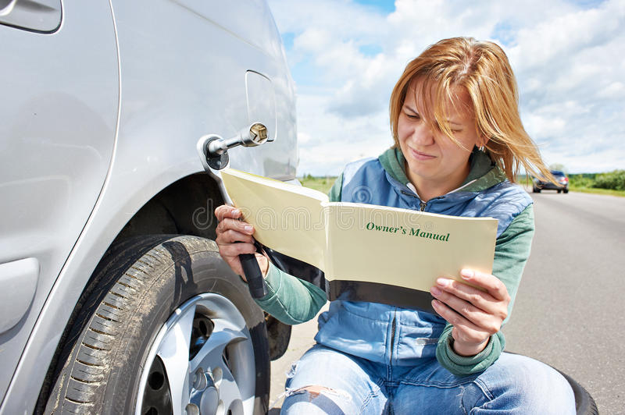
The Problem
Back
03/27
Next

Slide 4


The Solution
Past
What services should your car received in the past?
Present
What services your car might need in your current mileage?
Future
What services your car might require in the future?
Back
04/27
Next

Slide 5













Eskwelabs x Autoserved
DATA SCIENCE TOOLS
Integrated Development Environment & Software
Data Science Libraries
Deployment Apps
Tools that are primarily used to code and manipulate data.
Libraries that are used to perform data analysis and machine learning modeling
Applications that will be used for deployment and integration of our model.
Back
05/27
Next

Slide 6

Eskwelabs x Autoserved
Machine Learning Pipeline
Data Preprocessing
Data Cleaning
Modeling
Deployment
Dropped some null values and anomalous values
Dropped duplicate values
Imputed important rows with null values
Feature label and encoding
Splitting of labels
Oversampling
Hyperparameter tuning
Cross validation
Streamlit application
Back
06/27
Next

Slide 7
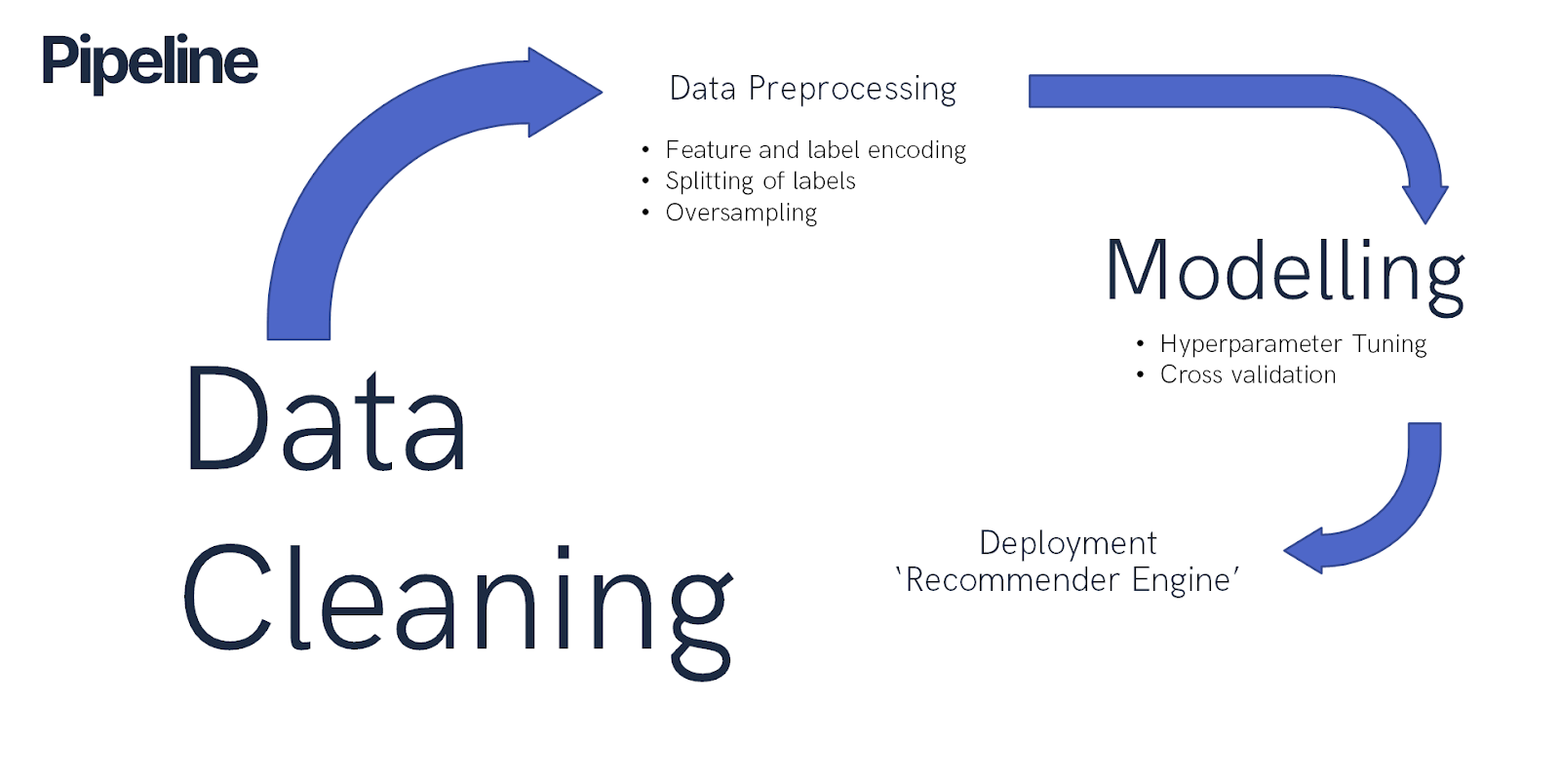
Back
05/27
Next

Slide 8
Eskwelabs x Autoserved
Mileage
The total distance that the vehicle has traveled since it was purchased.
Important Terminology
Car Make
The name of a car’s manufacturer.
Car Model
Refers to the name of a car product and sometimes a range of products.
Car Year
Method of describing the version of vehicle.
Service Category
General categorization of services offered in the car repair shops.
Back
07/27
Next

Slide 9
An increase of service transactions have been observed due to new customers with recently expired manufacturer warranty.
Majority of the transactions (60%) are around the 30k to 80k mileage category.
Back
08/27
Next

Slide 10
Eskwelabs x Autoserved
Toyota topped the list of car manufacturers with the most service transactions.
Reflective of Toyota’s almost 39% market share of total automotive sales in the Philippines and their parts availability in the market.
Source: Statista.com
Back
09/27
Next

Slide 11
Eskwelabs x Autoserved
The brands of Ford and Chevrolet topped the charts with the highest maintenance and repair cost per car make.
Back
10/27
Next

Slide 12
Eskwelabs x Autoserved
On average, 3 out of every 5 car owners go visit the car service centers for an Oil, Lube, & Preventive Maintenance Service.
Back
11/27
Next

Slide 13
Eskwelabs x Autoserved
Back
12/27
Next

Slide 14
This highly suggests that oil change is always included in preventive maintenance service.
Major preventive maintenance most likely to happen at the 50k and 90k mileage.
Back
15/27
Next

Slide 15
Back
13/27
Next

Slide 16
Back
14/27
Next

Slide 17
Eskwelabs x Autoserved
These are the service categories with records of less than 1000.
Back
16/27
Next

Slide 18
Eskwelabs x Autoserved
These are the service categories with records of more than 1000.
Back
17/27
Next

Slide 19
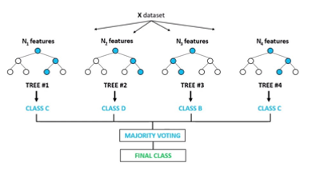


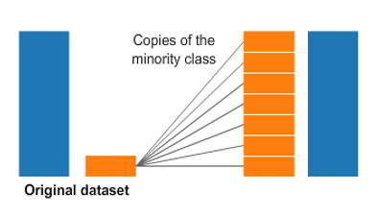
Random Forest Classifier
Eskwelabs x Autoserved
Model
Balanced Bagging Classifier
Oversampling
Back
18/27
Next

Slide 20
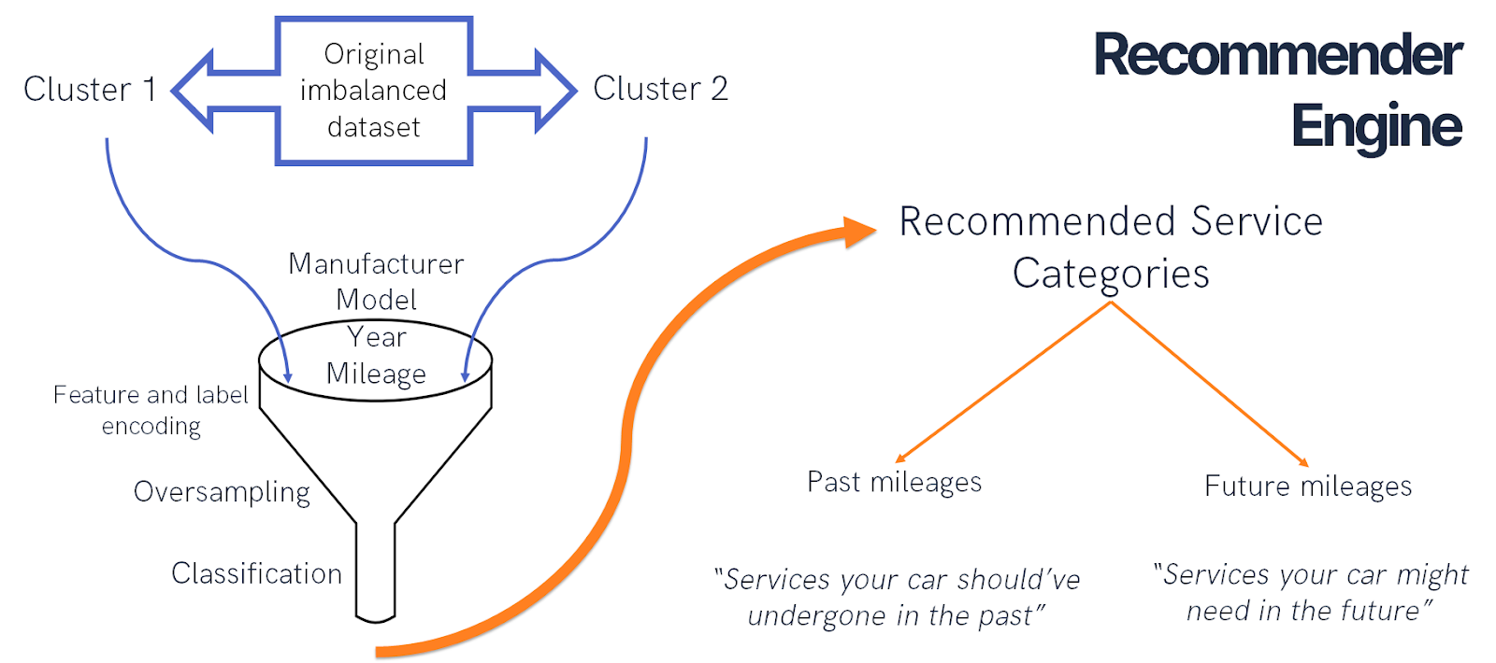
Back
19/27
Next

Slide 21
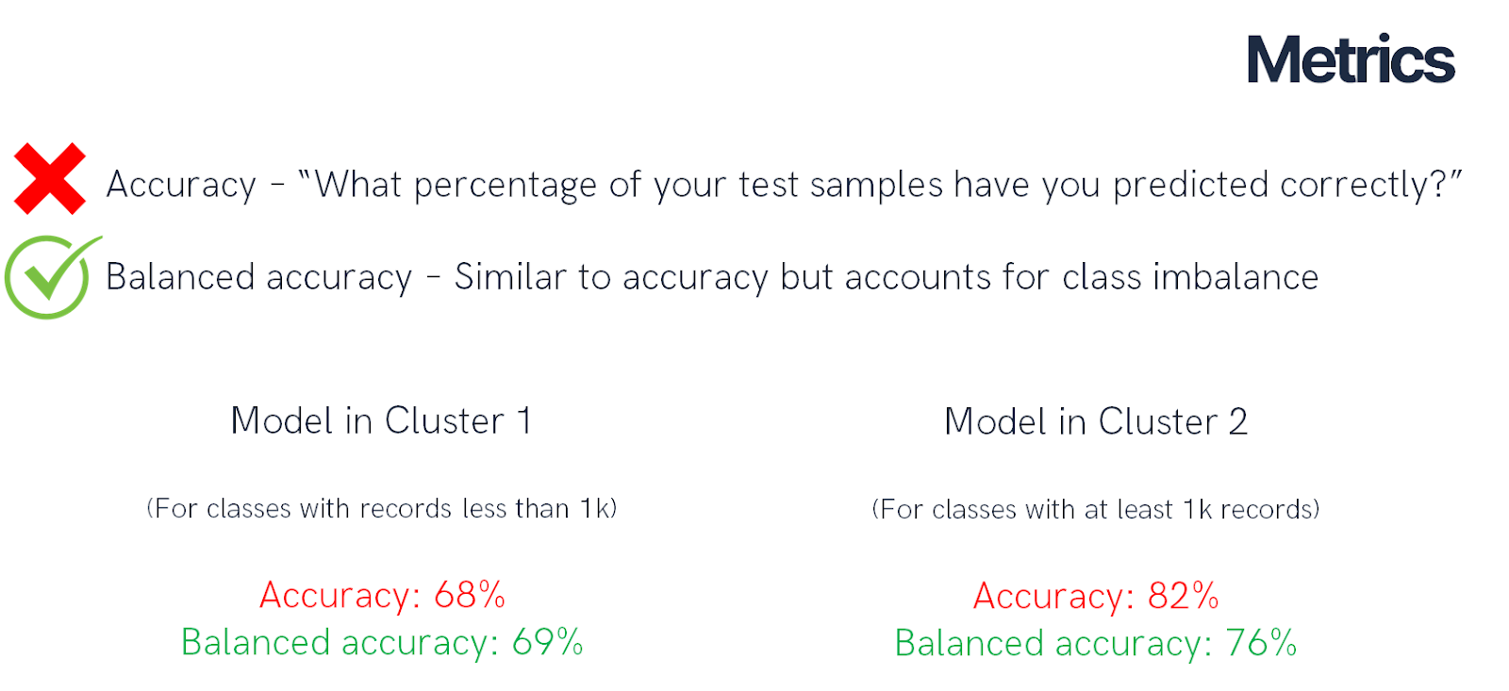
Back
20/27
Next

Slide 22
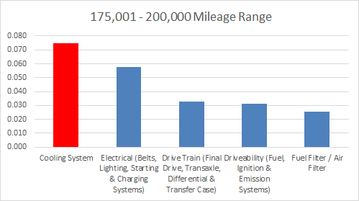
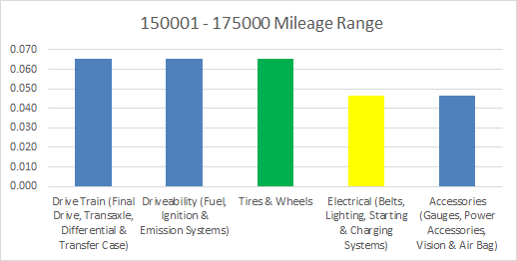
Test Sample (Model 1)
2016 Ford Everest - 188,124 kms
Past mileage recommendations | Mileage (kms)
Cooling System | 178,718
Electrical | 169,312
Tires and Wheels | 150,500
Back
21/27
Next

Slide 23
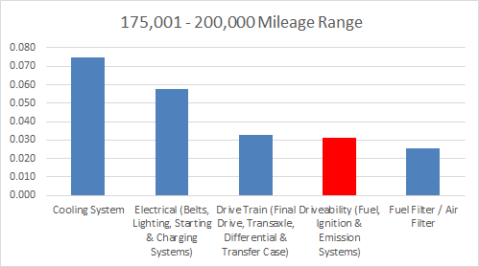
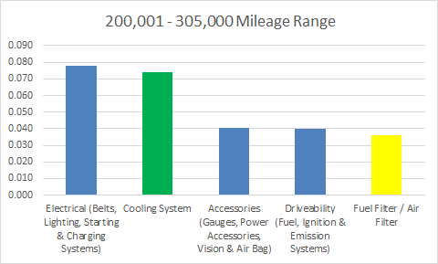
Test Sample (Model 1)
2016 Ford Everest - 188,124 kms
Future mileage recommendations | Mileage (kms)
Driveability | 197,530
Fuel filter / Air filter | 206,936
Cooling System | 216,342
Back
22/27
Next

Slide 24
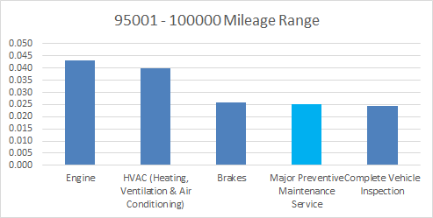
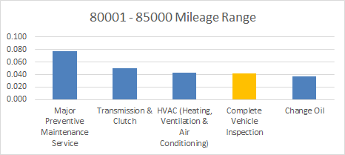
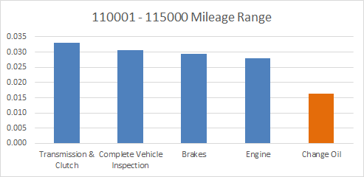
Test Sample (Model 2)
2012 Ford Fiesta – 116,767 kms
Past mileage recommendations | Mileage (kms)
Change Oil | 110,929
Major PMS | 99,253
Complete Vehicle Inspection | 81,739
Back
23/27
Next

Slide 25
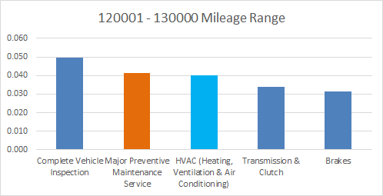
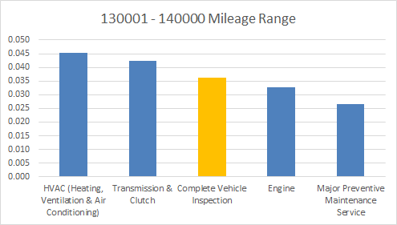
Test Sample (Model 2)
2012 Ford Fiesta – 116,767 kms
Future mileage recommendations | Mileage (kms)
Major PMS | 122,605
HVAC | 128,443
Complete Vehicle Inspection | 134,281
Back
24/27
Next

Slide 26
Demo
Back
25/27
Next

Slide 27
Eskwelabs x Autoserved
Recommendations
Try multi-label classification
Splitting the majority class/es even further to reduce imbalance
Make use of other encoders for nominal features
Increase the size of the dataset (then do under sampling)
Combining random under sampling and random oversampling
Back
26/27
Next

Slide 28




The Autoserved Team
Andre Gabriel Labayan
Melchor King Calma
Justine Paul Padayao
Patrick Nichol Nuguid
Data Scientist
Data Scientist
Data Scientist
Data Scientist
Back
27/27
Next

Slide 29
Appendices

Slide 30
Appendix A – Feature Importance

Slide 31
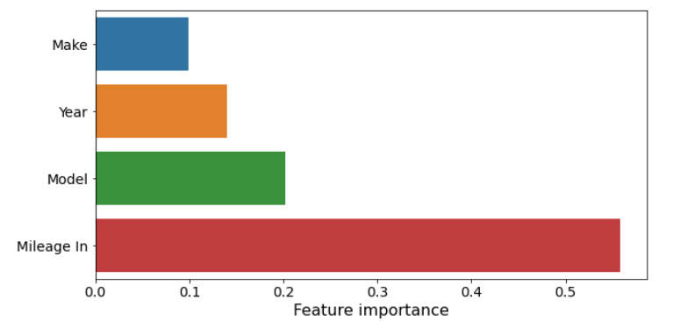
Model 1

Slide 32
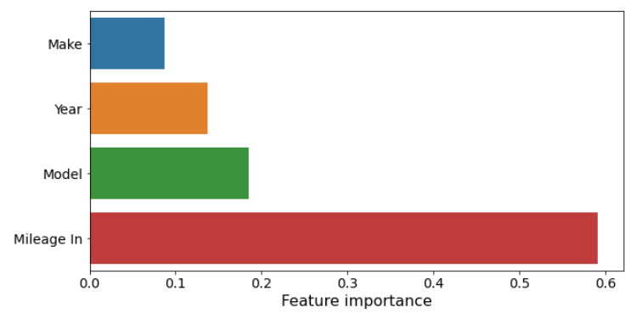
Model 2

Slide 33
Appendix B –
Cross-Validation Scores

Slide 34
Stratified Cross-Validation (Model 1)
Mean Accuracy: 0.6680682730923695
Mean Balanced accuracy: 0.6558033568206867
Mean f1-score_micro: 0.6680682730923695
Mean f1-score_macro: 0.6431849434165711

Slide 35
Stratified Cross-Validation (Model 2)
Mean Accuracy: 0.821010244986061
Mean Balanced accuracy: 0.7620855363355769
Mean f1-score_micro: 0.821010244986061
Mean f1-score_macro: 0.7389874962868361

Slide 36
Q & A

Slide 37
Why did you use target encoding?
In a nutshell, it uses the target variable as the basis to generate the new encoded feature.
From a mathematical point of view, mean encoding represents a probability of your target variable, conditional on each value of the feature. In a way, it embodies the target variable in its encoded value.
To conclude, what mean encoding does is it solves both the encoding task and also creates a feature that is more representative of the target variable — essentially killing two birds with one stone.
It also doesn’t increase the dimensionality of the dataset unlike binary encoding.

Slide 38
Eskwelabs x Autoserved
Majority of the cars being serviced are within the 30k to 80k mileage.
Hypothesis: There is an increase of customers since car owners have expired warranty when reaching this mileage.
Back
07/15
Next

Slide 39
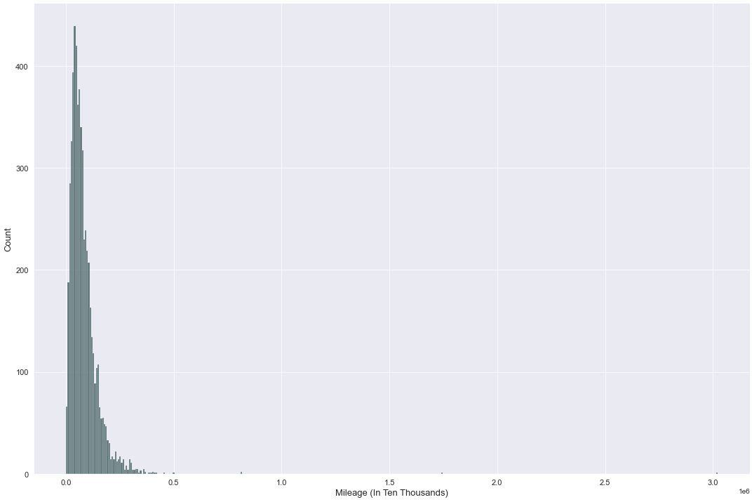
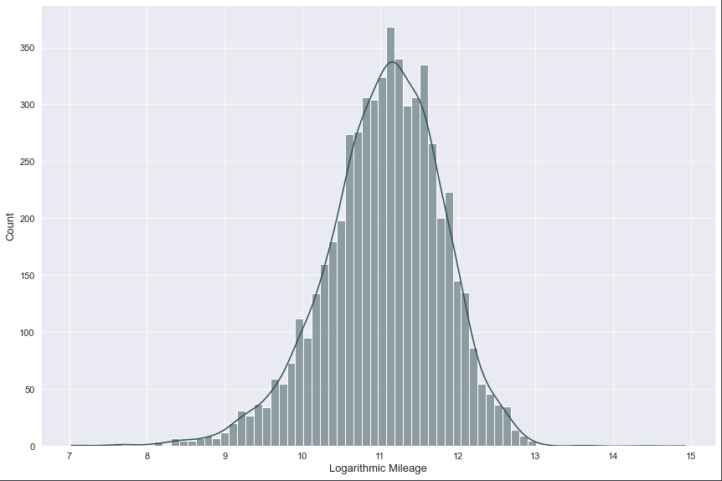
Mileage Analysis
Before Logarithmic Transformation
After Logarithmic Transformation
Skewness: 13.957
Kurtosis: 476.541
Normality Test | Statistic | P-Value | Conclusion
Shapiro Wilk Test | 0.9826858 | 8.7544357e -26 | Does not follow normal distribution
Lilliefors Test
Kolmogorov Smirnov Test
Back
04/05
Next

Slide 40
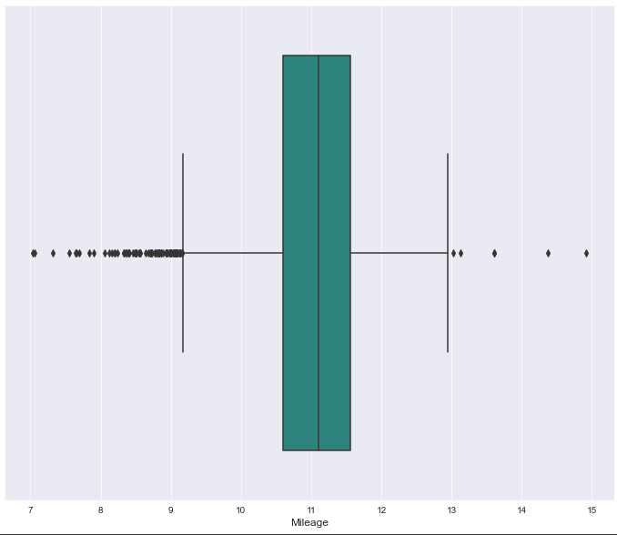
Mileage Analysis
Back
04/05
Next

Slide 41
Eskwelabs x Autoserved
Car owners typically have their cars serviced beginning on Friday and peaking on Saturday.
In addition, fewer people have their cars serviced on Sunday.
Note: Subject for review because the value stated is just the total count per day for a period of 4 years (2018 – 2021).
Back
09/15
Next

Slide 42
Eskwelabs x Autoserved
The majority of car owners preferred to have their vehicle serviced between the hours of 8 and 9 a.m.
After peak hours, the number of car owners visiting auto repair shops gradually decreases.
Note: Subject for review because the value stated is just the total count per hour for a period of 4 years (2018 – 2021).
Back
10/15
Next

Slide 43
Eskwelabs x Autoserved
The highest number of vehicles being serviced is around the month of January.
Note: Subject for review because the value stated is just the total count per month for a period of 4 years (2018 – 2021).
Back
11/15
Next

